Slide 1
Open Source Vulnerability Scanners
Lets take a look at OpenVAS
http://www.openvas.org/livedemo.html
Login and password: livedemo

Slide 2
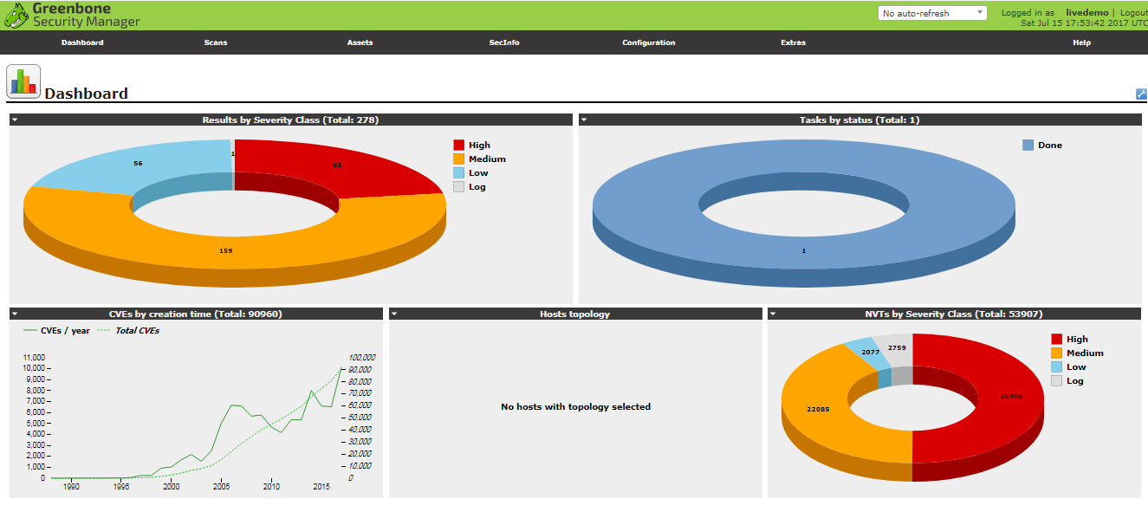
Open Source Vulnerability Scanners
DASHBOARD VIEW

Slide 3
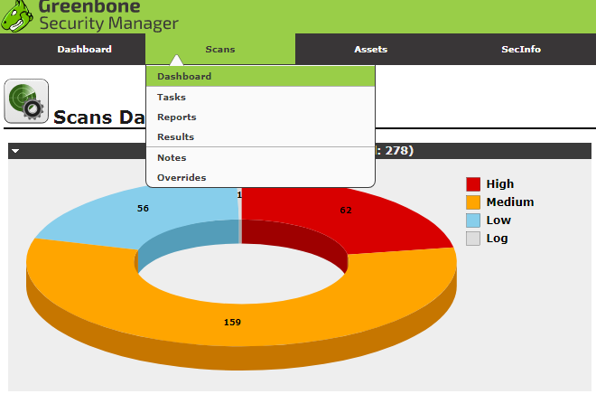
Open Source Vulnerability Scanners
SCANS DASHBOARD

Slide 4
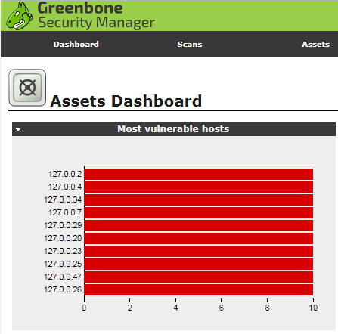
Open Source Vulnerability Scanners
ASSETS DASHBOARD

Slide 5
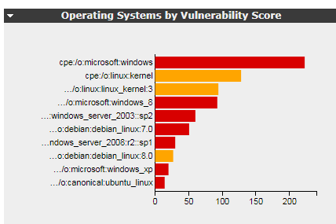
Open Source Vulnerability Scanners
OS BY VULNERABILITY SCORE

Slide 6
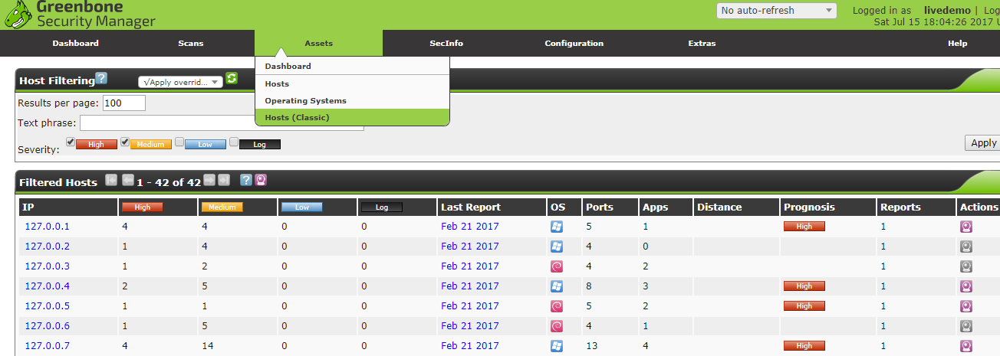
Open Source Vulnerability Scanners
ASSETS>HOSTS CLASSIC VIEW

Slide 7
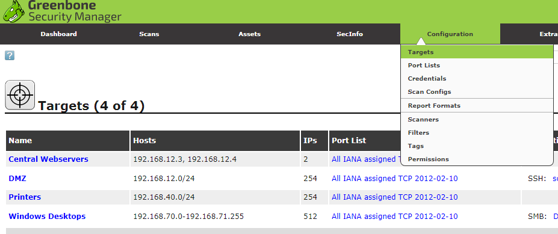
Open Source Vulnerability Scanners
CONFIGURATION > TARGETS

Slide 8
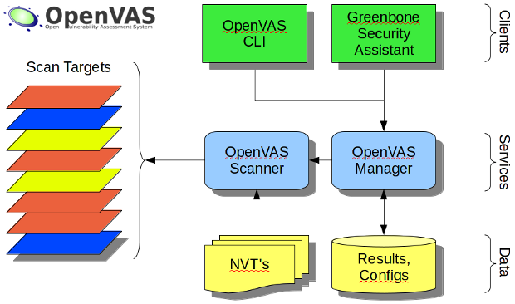
Open Source Vulnerability Scanners
OPENVAS ARCHITECTURE
APPROXIMATELY 50k NETWORK VULNERABILITY TESTS
http://www.openvas.org/software.html

Slide 9
Open Source Vulnerability Scanners
OpenVAS is a simple, free (opensource) VA scanner
It has source code documentation, virtual images for download, and mailing lists on its website
END

